Slide 1


Hosting Static Website on AWS S3
By: 2210080005_RAKESH, 2210080013_ABHAY, 2210080039_ABHINAV, 2210080069_SATYALOKESH

Slide 2

Introduction
• AWS S3 (Simple Storage Service) provides cloud storage.
• Supports hosting static websites using HTML, CSS, and JS.
• Cost-effective, scalable, and easy to set up.

Slide 3

Use Cases
• Hosting personal portfolios
• Simple company landing pages
• Documentation pages
• Event or campaign microsites

Slide 4
Architecture Diagram
Client (Browser)
↓
Amazon Route 53 (Optional for custom domain)
↓
Amazon S3 Bucket
↓
Static Website Files (index.html, style.css, etc.)

Slide 5

Step-by-Step Hosting
1. Create S3 Bucket
- Use a unique name and disable public access blocking.
2. Upload Website Files
- HTML, CSS, JS, etc.
3. Enable Static Website Hosting
- Set index and error documents.
4. Set Bucket Policy
- Make the content publicly accessible.

Slide 6
Bucket Policy (JSON)
{
"Version": "2012-10-17",
"Statement": [
{
"Effect": "Allow",
"Principal": "*",
"Action": "s3:GetObject",
"Resource": "arn:aws:s3:::your-bucket-name/*"
}
]
}

Slide 7

Accessing the Site
• Use the S3 website endpoint URL:
http://your-bucket.s3-website-region.amazonaws.com
• No need for a traditional web server.

Slide 8
Optional Enhancements
• Custom domain with Amazon Route 53
• Enable HTTPS with CloudFront and SSL
• Automate deployment using GitHub Actions or CodePipeline

Slide 9
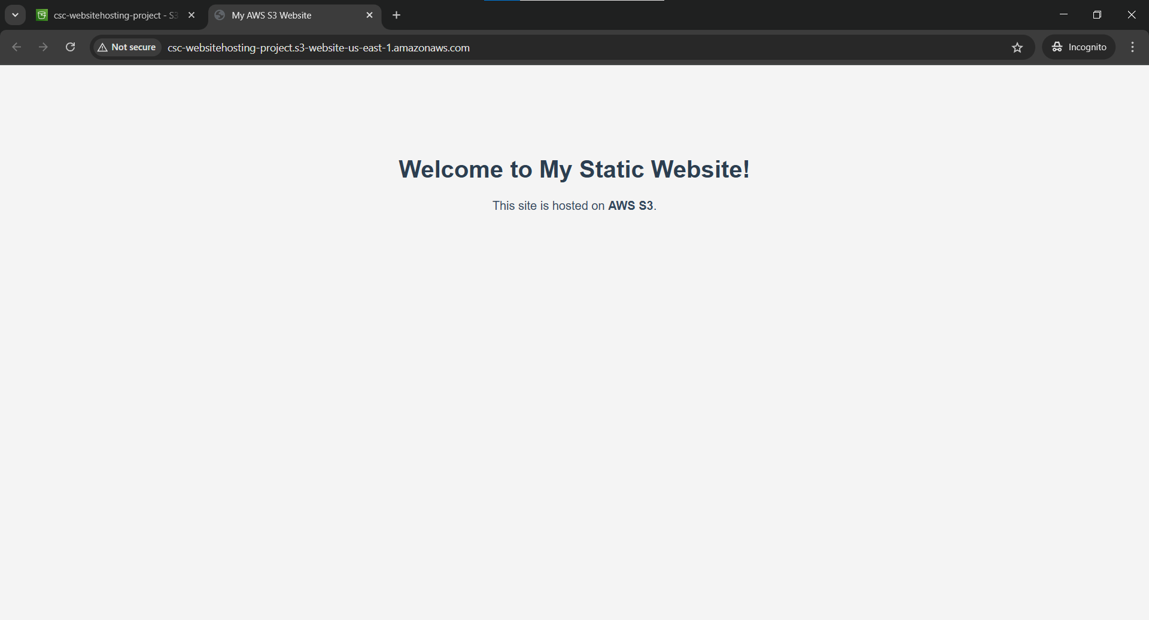

Slide 10

Conclusion
• Fast, serverless, and reliable hosting for static websites.
• Ideal for portfolios, landing pages, and documentation.

